Slide 1
Chapter 2
Instructions: Language of the Computer

Slide 2
Instruction Set
§2.1 Introduction
The repertoire of instructions of a computer
Different computers have different instruction sets
But with many aspects in common
Early computers had very simple instruction sets
Simplified implementation
Many modern computers also have simple instruction sets

Slide 3
The MIPS Instruction Set
Used as the example throughout the book
Stanford MIPS commercialized by MIPS Technologies (www.mips.com)
Large share of embedded core market
Applications in consumer electronics, network/storage equipment, cameras, printers, …
Typical of many modern ISAs
See MIPS Reference Data tear-out card, and Appendixes B and E
Notes:
MIPS: this is the CPU we will study his instruction .

Slide 4

Arithmetic Operations
§2.2 Operations of the Computer Hardware
Add and subtract, three operands
Two sources and one destination
add a, b, c # a gets b + c
All arithmetic operations have this form
Design Principle 1: Simplicity favours regularity
Regularity makes implementation simpler
Simplicity enables higher performance at lower cost

Slide 5
Arithmetic Example
C code:
f = (g + h) - (i + j);
Compiled MIPS code:
add t0, g, h # temp t0 = g + h add t1, i, j # temp t1 = i + j sub f, t0, t1 # f = t0 - t1

Slide 6
Register Operands
§2.3 Operands of the Computer Hardware
Arithmetic instructions use register operands
MIPS has a 32 × 32-bit register file
Use for frequently accessed data
Numbered 0 to 31
32-bit data called a “word”
Assembler names
$t0, $t1, …, $t9 for temporary values
$s0, $s1, …, $s7 for saved variables
Design Principle 2: Smaller is faster
c.f. main memory: millions of locations

Slide 7
Register Operand Example
C code:
f = (g + h) - (i + j);
f, …, j in $s0, …, $s4
Compiled MIPS code:
add | $t0, | $s1, | $s2
add | $t1, | $s3, | $s4
sub | $s0, | $t0, | $t1

Slide 8
Memory Operands
Main memory used for composite data
Arrays, structures, dynamic data
To apply arithmetic operations
Load values from memory into registers
Store result from register to memory
Memory is byte addressed
Each address identifies an 8-bit byte
Words are aligned in memory
Address must be a multiple of 4
MIPS is Big Endian
Most-significant byte at least address of a word
c.f. Little Endian: least-significant byte at least address

Slide 9
Memory Operand Example 1
C code:
g = h + A[8];
g in $s1, h in $s2, base address of A in $s3
Compiled MIPS code:
Index 8 requires offset of 32
4 bytes per word
lw $t0, 32($s3) # load word add $s1, $s2, $t0
offset
base register

Slide 10
Memory Operand Example 2
C code:
A[12] = h + A[8];
h in $s2, base address of A in $s3
Compiled MIPS code:
Index 8 requires offset of 32
lw | $t0, | 32($s3) | # | load | word
add | $t0, | $s2, $t0
sw | $t0, | 48($s3) | # | store | word
Notes:
Note That we don’t need to use save variable register

Slide 11
Registers vs. Memory
Registers are faster to access than memory
Operating on memory data requires loads and stores
More instructions to be executed
Compiler must use registers for variables as much as possible
Only spill to memory for less frequently used variables
Register optimization is important!

Slide 12
Immediate Operands
Constant data specified in an instruction
addi $s3, $s3, 4
No subtract immediate instruction
Just use a negative constant
addi $s2, $s1, -1
Design Principle 3: Make the common case fast
Small constants are common
Immediate operand avoids a load instruction

Slide 13
The Constant Zero
MIPS register 0 ($zero) is the constant 0
Cannot be overwritten
Useful for common operations
E.g., move between registers
add $t2, $s1, $zero

Slide 14
Unsigned Binary Integers
§2.4 Signed and Unsigned Numbers
Given an n-bit number
x = x 2
n−1 n−2
1 0
+ x 2 +☹+ x 2 + x 2
n−1 n−2 1 0
Range: 0 to +2^{n} – 1
Example
0000 0000 0000 0000 0000 0000 0000 1011₂
= 0 + … + 1×2³ + 0×2² +1×2¹ +1×2⁰
= 0 + … + 8 + 0 + 2 + 1 = 11₁₀
Using 32 bits
0 to +4,294,967,295

Slide 15
2s-Complement Signed Integers
Given an n-bit number
n−1 n−2 1
0
x = −x_{n−1}2 + x_{n−2} 2 +☹+ x 2 + x
2
1 0
Range: –2^{n – 1} to +2^{n – 1} – 1
Example
1111 1111 1111 1111 1111 1111 1111 1100₂
= –1×2³¹ + 1×2³⁰ + … + 1×2² +0×2¹ +0×2⁰
= –2,147,483,648 + 2,147,483,644 = –4₁₀
Using 32 bits
–2,147,483,648 to +2,147,483,647

Slide 16
2s-Complement Signed Integers
Bit 31 is sign bit
1 for negative numbers
0 for non-negative numbers
–(–2^{n – 1}) can’t be represented
Non-negative numbers have the same unsigned and 2s-complement representation
Some specific numbers
0: 0000 0000 … 0000
–1: 1111 1111 … 1111
Most-negative: 1000 0000 … 0000
Most-positive: 0111 1111 … 1111

Slide 17
Signed Negation
Complement and add 1
Complement means 1 → 0, 0 → 1
x + x = 1111...111₂ = −1
x + 1= −x
Example: negate +2
■ +2 = 0000 0000 … 0010₂
–2 = 1111 1111 … 1101₂ + 1
= 1111 1111 … 1110₂

Slide 18
Sign Extension
Representing a number using more bits
Preserve the numeric value
In MIPS instruction set
addi: extend immediate value
lb, lh: extend loaded byte/halfword
beq, bne: extend the displacement
Replicate the sign bit to the left
c.f. unsigned values: extend with 0s
Examples: 8-bit to 16-bit
■ +2: 0000 0010 => 0000 0000 0000 0010
–2: 1111 1110 => 1111 1111 1111 1110

Slide 19
Representing Instructions
§2.5 Representing Instructions in the Computer
Instructions are encoded in binary
Called machine code
MIPS instructions
Encoded as 32-bit instruction words
Small number of formats encoding operation code (opcode), register numbers, …
Regularity!
Register numbers
$t0 – $t7 are reg’s 8 – 15
$t8 – $t9 are reg’s 24 – 25
$s0 – $s7 are reg’s 16 – 23
Notes:
The number of registers save it in worse case .

Slide 20
MIPS R-format Instructions
op | rs | rt | rd | shamt | funct
6 bits 5 bits 5 bits 5 bits 5 bits 6 bits
Instruction fields
op: operation code (opcode)
rs: first source register number
rt: second source register number
rd: destination register number
shamt: shift amount (00000 for now)
funct: function code (extends opcode)

Slide 21
R-format Example
op | rs | rt | rd | shamt | funct
6 bits
5 bits
5 bits
5 bits
5 bits
6 bits
add $t0, $s1, $s2
special | $s1 | $s2 | $t0 | 0 | add
0 | 17 | 18 | 8 | 0 | 32
000000 | 10001 | 10010 | 01000 | 00000 | 100000
00000010001100100100000000100000₂ = 02324020₁₆

Slide 22
Hexadecimal
Base 16
Compact representation of bit strings
4 bits per hex digit
0 | 0000 | 4 | 0100 | 8 | 1000 | c | 1100
1 | 0001 | 5 | 0101 | 9 | 1001 | d | 1101
2 | 0010 | 6 | 0110 | a | 1010 | e | 1110
3 | 0011 | 7 | 0111 | b | 1011 | f | 1111
Example: eca8 6420
1110 1100 1010 1000 0110 0100 0010 0000

Slide 23
MIPS I-format Instructions
op | rs | rt | constant or address
6 bits 5 bits 5 bits 16 bits
Immediate arithmetic and load/store instructions
rt: destination or source register number
Constant: –2¹⁵ to +2¹⁵ – 1
Address: offset added to base address in rs
Design Principle 4: Good design demands good compromises
Different formats complicate decoding, but allow 32-bit instructions uniformly
Keep formats as similar as possible

Slide 24
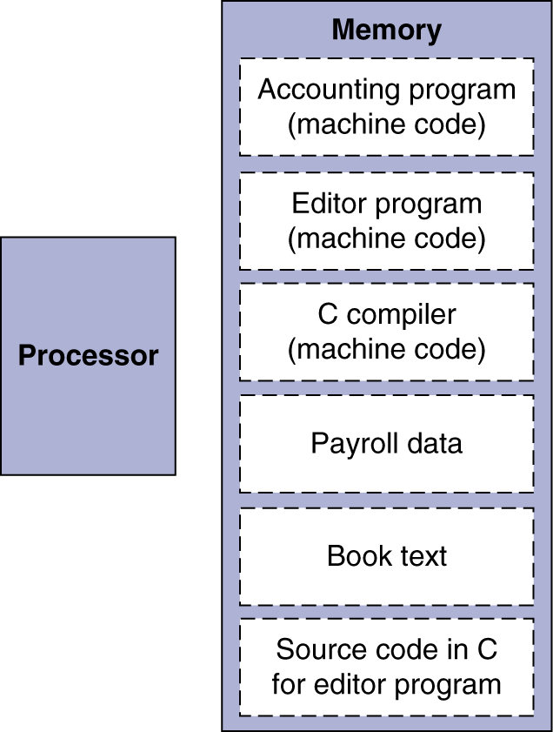
Stored Program Computers
Instructions represented in binary, just like data
Instructions and data stored in memory
Programs can operate on programs
e.g., compilers, linkers, …
Binary compatibility allows compiled programs to work on different computers
Standardized ISAs
The BIG Picture

Slide 25
Logical Operations
§2.6 Logical Operations
Instructions for bitwise manipulation
Operation | C | Java | MIPS
Shift left | << | << | sll
Shift right | >> | >>> | srl
Bitwise AND | & | & | and, andi
Bitwise OR | | | | | or, ori
Bitwise NOT | ~ | ~ | nor
Useful for extracting and inserting groups of bits in a word
Notes:
You must understand this slide very well

Slide 26
Shift Operations
op | rs | rt | rd | shamt | funct
6 bits 5 bits 5 bits 5 bits 5 bits 6 bits
shamt: how many positions to shift
Shift left logical
Shift left and fill with 0 bits
sll by i bits multiplies by 2^{i}
Shift right logical
Shift right and fill with 0 bits
srl by i bits divides by 2^{i} (unsigned only)

Slide 27
AND Operations
Useful to mask bits in a word
Select some bits, clear others to 0
and $t0, $t1, $t2
$t2
$t1
$t0
0000 0000 0000 0000 000 | 0 110 | 1 1100 0000
0000 0000 0000 0000 00 | 11 110 | 0 0000 0000
0000 0000 0000 0000 000 | 0 110 | 0 0000 0000

Slide 28
OR Operations
Useful to include bits in a word
Set some bits to 1, leave others unchanged
or $t0, $t1, $t2
$t2
$t1
$t0
0000 0000 0000 0000 000 | 0 110 | 1 1100 0000
0000 0000 0000 0000 00 | 11 110 | 0 0000 0000
0000 0000 0000 0000 00 | 11 110 | 1 1100 0000

Slide 29
NOT Operations
Useful to invert bits in a word
Change 0 to 1, and 1 to 0
MIPS has NOR 3-operand instruction
a NOR b == NOT ( a OR b )
nor $t0, $t1, $zero
Register 0: always read as zero
$t1
0000 0000 0000 0000 0011 1100 0000 0000
$t0
1111 1111 1111 1111 1100 0011 1111 1111

Slide 30
Conditional Operations
§2.7 Instructions for Making Decisions
Branch to a labeled instruction if a condition is true
Otherwise, continue sequentially
beq rs, rt, L1
if (rs == rt) branch to instruction labeled L1;
bne rs, rt, L1
if (rs != rt) branch to instruction labeled L1;
j L1
unconditional jump to instruction labeled L1

Slide 31
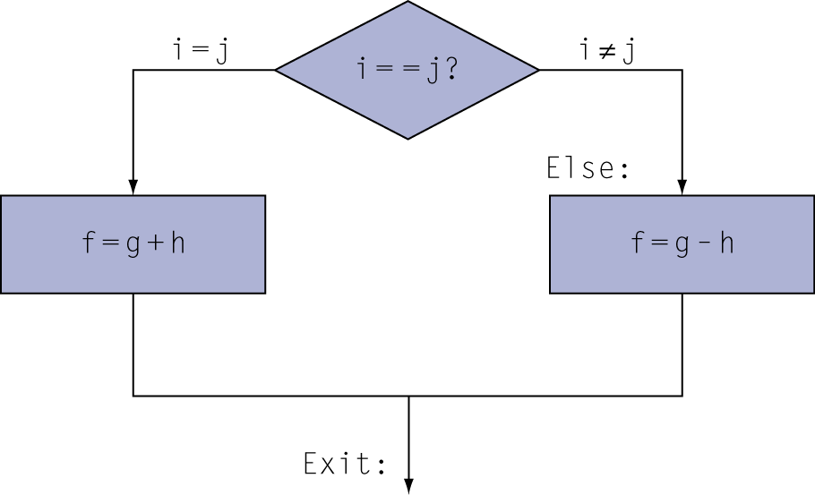
Compiling If Statements
C code:
if (i==j) f = g+h; else f = g-h;
f, g, … in $s0, $s1, …
Compiled MIPS code:
bne $s3, add $s0, j Exit sub $s0,
…
$s4, Else
$s1, $s2
Else: Exit:
$s1, $s2
Assembler calculates addresses

Slide 32
Compiling Loop Statements
C code:
while (save[i] == k) i += 1;
i in $s3, k in $s5, address of save in $s6
Compiled MIPS code:
Loop: | sll | $t1, | $s3, | 2
 | add | $t1, | $t1, | $s6
lw |  | $t0, | 0($t1)
bne |  | $t0, | $s5, Exit
addi |  | $s3, | $s3, 1
j |  | Loop
Exit: …

Slide 33
Basic Blocks
A basic block is a sequence of instructions with
No embedded branches (except at end)
No branch targets (except at beginning)
A compiler identifies basic blocks for optimization
An advanced processor can accelerate execution of basic blocks

Slide 34
More Conditional Operations
Set result to 1 if a condition is true
Otherwise, set to 0
slt rd, rs, rt
if (rs < rt) rd = 1; else rd = 0;
slti rt, rs, constant
if (rs < constant) rt = 1; else rt = 0;
Use in combination with beq, bne
slt $t0, $s1,
bne $t0,
$s2 # if ($s1 < $s2)
# branch to L
$zero, L

Slide 35
Branch Instruction Design
Why not blt, bge, etc?
Hardware for <, ≥, … slower than =, ≠
Combining with branch involves more work per instruction, requiring a slower clock
All instructions penalized!
beq and bne are the common case
This is a good design compromise

Slide 36
Signed vs. Unsigned
Signed comparison: slt, slti
Unsigned comparison: sltu, sltui
Example
$s0 = 1111 1111 1111 1111 1111 1111 1111 1111
$s1 = 0000 0000 0000 0000 0000 0000 0000 0001
slt $t0, $s0, $s1 # signed
–1 < +1 ⇒ $t0 = 1
sltu $t0, $s0, $s1 # unsigned
+4,294,967,295 > +1 ⇒ $t0 = 0

Slide 37
Register Usage
$a0 – $a3: arguments (reg’s 4 – 7)
$v0, $v1: result values (reg’s 2 and 3)
$t0 – $t9: temporaries
Can be overwritten by callee
$s0 – $s7: saved
Must be saved/restored by callee
$gp: global pointer for static data (reg 28)
$sp: stack pointer (reg 29)
$fp: frame pointer (reg 30)
$ra: return address (reg 31)

Slide 38
Branch Addressing
Branch instructions specify
Opcode, two registers, target address
Most branch targets are near branch
Forward or backward
6 bits 5 bits 5 bits 16 bits
PC-relative addressing
Target address = PC + offset × 4
PC already incremented by 4 by this time
op | rs | rt | constant or address
Notes:
We also take about it important information in the note in next slide.

Slide 39
Jump Addressing
Jump (j and jal) targets could be anywhere in text segment
Encode full address in instruction
op
address
6 bits
26 bits
(Pseudo)Direct jump addressing
Target address = PC_{31…28} : (address × 4)

Slide 40
Target Addressing Example
Loop code from earlier example
Assume Loop at location 80000
Loop: sll | $t1, | $s3, 4 | 80000 | 0 | 0 | 19 | 9 | 4 | 0
add | $t1, | $t1, $s6 | 80004 | 0 | 9 | 22 | 9 | 0 | 32
lw | $t0, | 0($t1) | 80008 | 35 | 9 | 8 |  | 0
bne | $t0, | $s5, Exit | 80012 | 5 | 8 | 21 |  | 2
addi | $s3, | $s3, 1 | 80016 | 8 | 19 | 19 |  | 1
j | Loop |  | 80020 | 2 |  | 20000
Exit: … |  |  | 80024

Slide 41
Branching Far Away
If branch target is too far to encode with 16-bit offset, assembler rewrites the code
Example
beq $s0,$s1, L1
↓
bne $s0,$s1, L2 j L1
L2: …

Slide 42
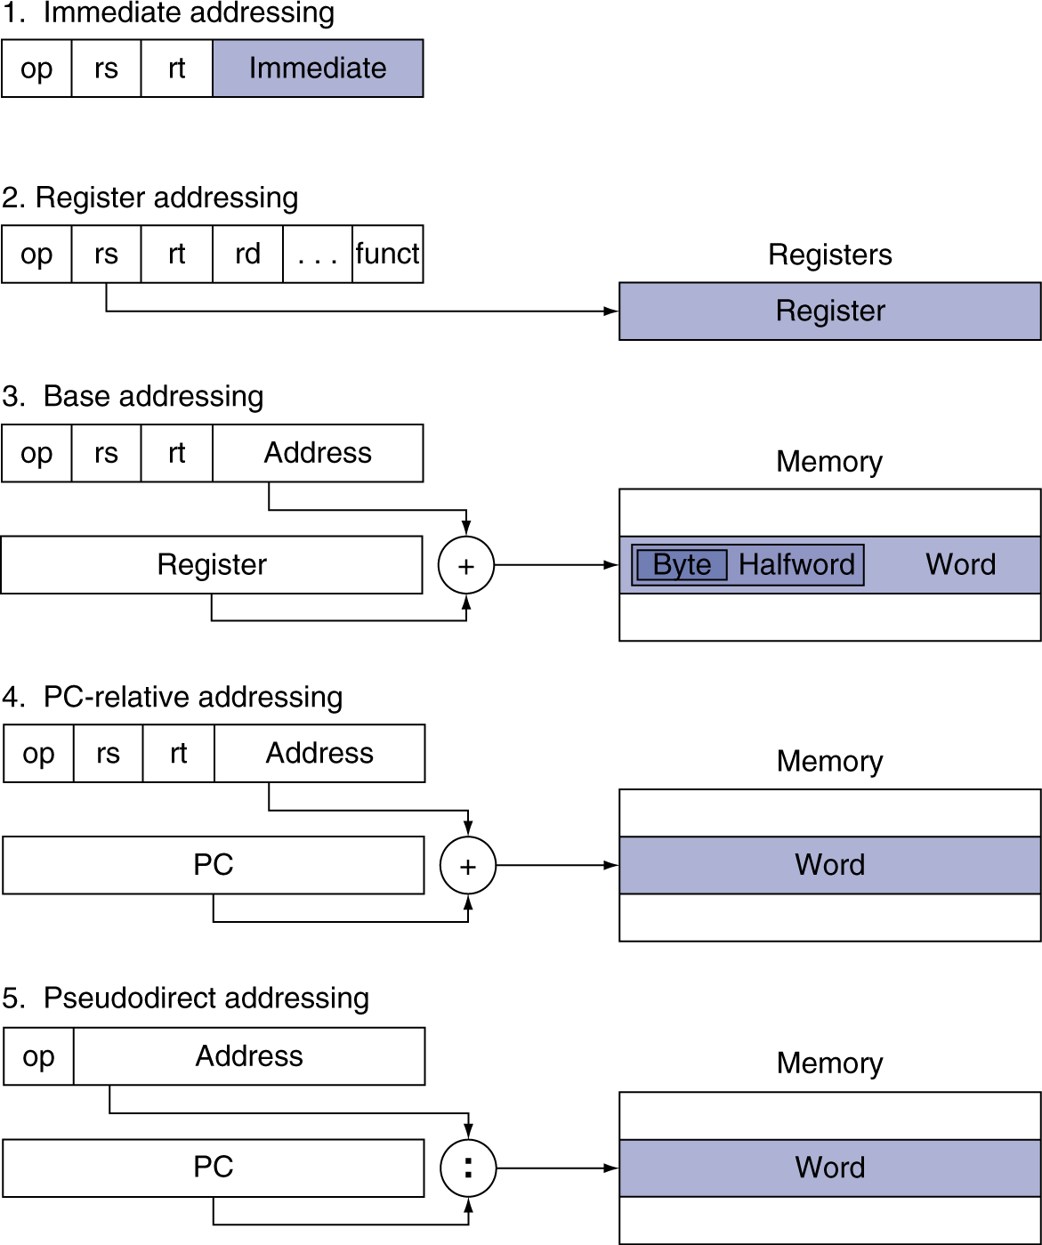
Addressing Mode Summary
Notes:
The Doctor did not stop on this slide but you must understand it

Slide 43
Effect of Compiler Optimization
Compiled with gcc for Pentium 4 under Linux
3
2.5
2
1.5
1
0.5
0
Relative Performance
140000
120000
100000
80000
60000
40000
20000
0
Instruction count
none
O1
O2
O3
none
O1
O2
O3
180000
160000
140000
120000
100000
80000
60000
40000
20000
0
Clock Cycles
2
CPI
1.5
1
0.5
0
none
O1
O2
O3
none
O1
O2
O3

Slide 44
Effect of Language and Algorithm
3
2.5
2
1.5
1
0.5
0
Bubblesort Relative Performance
C/none
C/O1
C/O2
C/O3
Java/int
Java/JIT
2.5
Quicksort Relative Performance
2
1.5
1
0.5
0
C/none
C/O1
C/O2
C/O3
Java/int
Java/JIT
3000
2500
2000
1500
1000
500
0
Quicksort vs. Bubblesort Speedup
C/none
C/O1
C/O2
C/O3
Java/int
Java/JIT

Slide 45
Lessons Learnt
Instruction count and CPI are not good performance indicators in isolation
Compiler optimizations are sensitive to the algorithm
Java/JIT compiled code is significantly faster than JVM interpreted
Comparable to optimized C in some cases
Nothing can fix a dumb algorithm!

Slide 46
Fallacies
§2.18 Fallacies and Pitfalls
Powerful instruction ⇒ higher performance
Fewer instructions required
But complex instructions are hard to implement
May slow down all instructions, including simple ones
Compilers are good at making fast code from simple instructions
Use assembly code for high performance
But modern compilers are better at dealing with modern processors
More lines of code ⇒ more errors and less
productivity

Slide 47
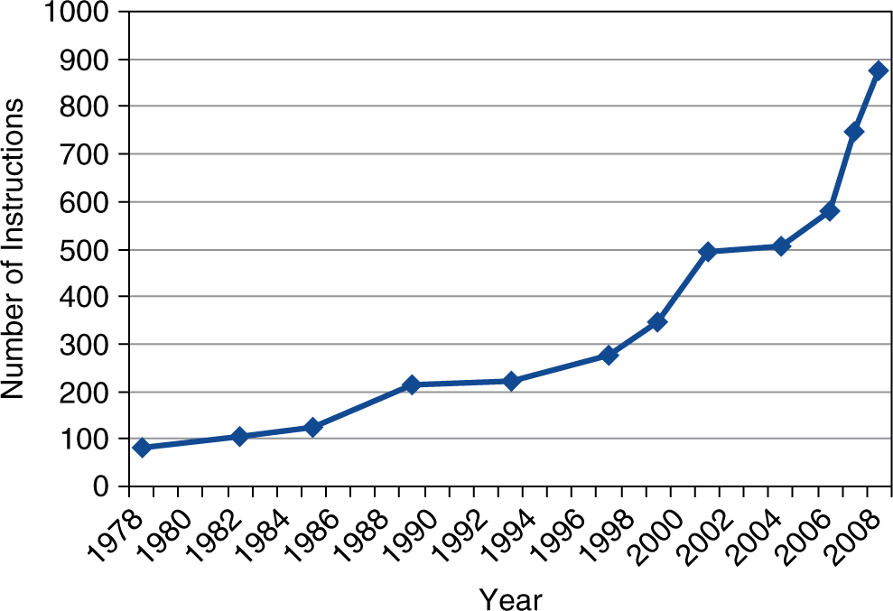
Fallacies
Backward compatibility ⇒ instruction set doesn’t change
But they do accrete more instructions
x86 instruction set

Slide 48
Pitfalls
Sequential words are not at sequential addresses
Increment by 4, not by 1!
Keeping a pointer to an automatic variable after procedure returns
e.g., passing pointer back via an argument
Pointer becomes invalid when stack popped

Slide 49
Concluding Remarks
§2.19 Concluding Remarks
Design principles
Simplicity favors regularity
Smaller is faster
Make the common case fast
Good design demands good compromises
Layers of software/hardware
Compiler, assembler, hardware
MIPS: typical of RISC ISAs
c.f. x86

Slide 50

 | Concluding Remarks
 | Measure MIPS instruction executions in benchmark programs Consider making the common case fast Consider compromises
In | struction class | MIPS examples | SPEC2006 Int | SPEC2006 FP
 | Arithmetic | add, sub, addi | 16% | 48%
 |  | lw, sw, lb, lbu, lh, lhu, sb, lui | 35% | 36%
Data transfer
Logical |  | and, or, nor, andi, ori, sll, srl | 12% | 4%
Cond. Branch |  | beq, bne, slt, slti, sltiu | 34% | 8%
Jump |  | j, jr, jal | 2% | 0%

